Slide 1

© 2002, Cisco Systems, Inc. All rights reserved.

Slide 2
Determining IP Routes
Module 5
Notes:
Purpose: This chapter introduces the Cisco IOS™ CLI on the Catalyst® 1900 switch and router.
Timing: This chapter should take about 2 hours to present.
Note: The Catalyst 1900 switch only has a subset of the router Cisco IOS commands available.
Contents:
Introduction to Cisco IOS. Explain to the student what is IOS?
Cisco Device startup procedures in general.
IOS configuration source.
General introduction to the IOS CLI.
Cat 1900 switch startup procedures.
Intro to Cat 1900 CLI. This part covers the basic configuration on the switch, like setting the IP address and hostname. More details about the various Cat 1900 switch configuration commands are explained in Chapter 6 and 7.
Router startup procedures. More details on the router startup process is discussed in chapter 5.
Router IOS CLI.

Slide 3
Objectives
Upon completing this lesson, you will be able to:
  Describe the features and operation of static routing
  Describe the features and operation of dynamic routing protocols, including RIP, IGRP, EIGRP,
  and OSPF
  Build a functional router configuration to support the specified network operational requirements, given a network design
  Use show commands to identify anomalies in routing operation, given an operational router
  Use debug commands to identify events and anomalies in routing operation, given an operational router
Notes:
Slide 1 of 2
Purpose: This slide states the chapter objectives.
Emphasize: Read or state each objective so that each student has a clear understanding of the chapter objectives.
Note: Catalyst switches have different CLIs. The Catalyst 2900xl and the Catalyst 1900 has a Cisco IOS CLI. The Cisco IOS CLI commands available on the 2900xl is different from the 1900. The Catalyst 5000 family has no Cisco IOS CLI, and use the set commands instead. This class only covers the configuration on the Catalyst 1900 switch.

Slide 4

Routing Overview
© 2002, Cisco Systems, Inc. All rights reserved.
Notes:
Purpose: This chapter introduces the Cisco IOS™ CLI on the Catalyst® 1900 switch and router.
Timing: This chapter should take about 2 hours to present.
Note: The Catalyst 1900 switch only has a subset of the router Cisco IOS commands available.
Contents:
Introduction to Cisco IOS. Explain to the student what is IOS?
Cisco Device startup procedures in general.
IOS configuration source.
General introduction to the IOS CLI.
Cat 1900 switch startup procedures.
Intro to Cat 1900 CLI. This part covers the basic configuration on the switch, like setting the IP address and hostname. More details about the various Cat 1900 switch configuration commands are explained in Chapter 6 and 7.
Router startup procedures. More details on the router startup process is discussed in chapter 5.
Router IOS CLI.

Slide 5
Objectives
Upon completing this lesson, you will be able to:
  Explain the differences between static routing and dynamic routing
  Identify the classes of routing protocols
  Use Cisco IOS commands to configure static routes and default route forwarding, given a functioning router
  Use show commands to identify anomalies in static routing operation, given an operational router
  Describe the operation of “router on a stick”
  Configure router on a stick for inter-VLAN routing using ISL and 802.1Q trunking, given an operational switch and router
Notes:
Slide 1 of 2
Purpose: This slide states the chapter objectives.
Emphasize: Read or state each objective so that each student has a clear understanding of the chapter objectives.
Note: Catalyst switches have different CLIs. The Catalyst 2900xl and the Catalyst 1900 has a Cisco IOS CLI. The Cisco IOS CLI commands available on the 2900xl is different from the 1900. The Catalyst 5000 family has no Cisco IOS CLI, and use the set commands instead. This class only covers the configuration on the Catalyst 1900 switch.

Slide 6
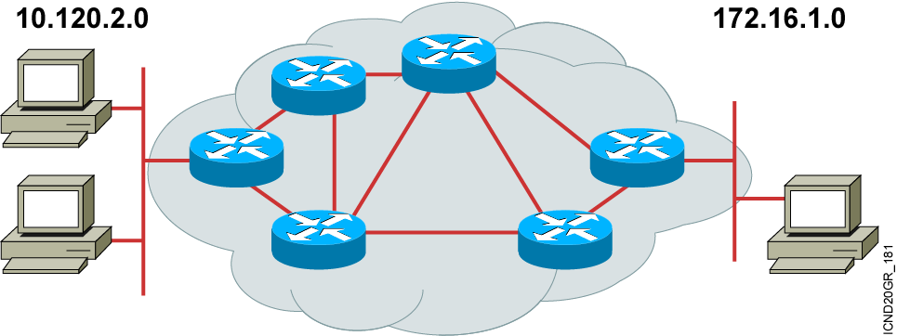
What Is Routing?
To route, a router needs to do the following:
  Know the destination address
  Identify the sources it can learn from
  Discover possible routes
  Select the best route
  Maintain and verify routing information
Notes:
Slide 1 of 2
Purpose: This figure introduces students to routing. The router must accomplish the items listed in the figure for routing to occur.
Emphasize: Path determination occurs at Layer 3, the network layer. The path determination function enables a router to evaluate the available paths to a destination and to establish the best path.
Routing services use network topology information when evaluating network paths. This information can be configured by the network administrator (static routes) or collected through dynamic processes (routing protocols) running in the network.
Transition: How do you represent the path to the packet’s destination?

Slide 7
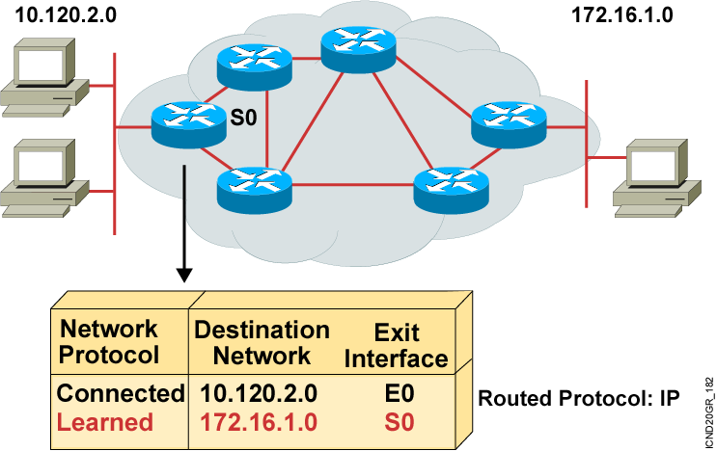
What Is Routing? (Cont.)
  Routers must learn destinations that are not directly connected.
Notes:
Slide 2 of 2
Purpose: This figure explains that routers must learn about paths that are not directly connected.
Emphasize: The router already knows about directly connected networks. It must learn about those networks that are not connected. This chapter describes how routers learn about those paths.

Slide 8
Identifying Static and Dynamic Routes
Static Route
  Uses a route that a network administrator enters into the router manually
Dynamic Route
  Uses a route that a network routing protocol adjusts automatically for topology or traffic changes
Notes:
Purpose: This figure introduces students to static and dynamic routes.
Emphasize: Static knowledge is administered manually—a network administrator enters it into the router’s configuration. The administrator must manually update this static route entry whenever an internetwork topology change requires an update. Static knowledge can be private—by default it is not conveyed to other routers as part of an update process. You can, however, configure the router to share this knowledge.
Dynamic knowledge works differently. After the network administrator enters configuration commands to start dynamic routing, route knowledge is updated automatically by a routing process. Whenever new topology information is received from the internetwork, routers update neighbors about the route change.

Slide 9
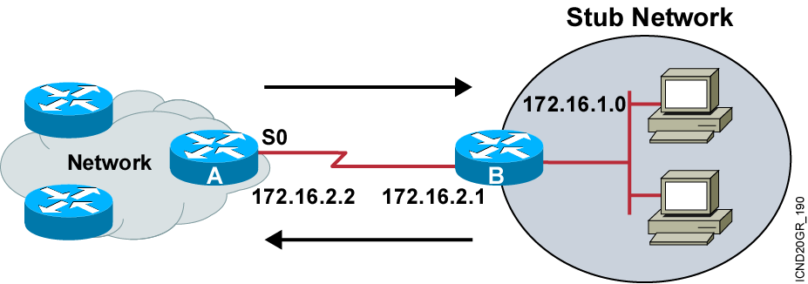
Static Routes
  Configure unidirectional static routes to and from a stub network to allow communications to occur.
Notes:
Purpose: This figure describes how a static route operates.
Emphasize: For intercommunication, static routes must be configured in both directions. Static routes are often used to route traffic to a stub network or other network where only a single route to that network exists.

Slide 10
Static Route Configuration
Router(config)#ip route network [mask]
{address | interface}[distance] [permanent]
  Defines a path to an IP destination network or subnet or host
Notes:
Purpose: This figure describes the command syntax used to establish an IP static route.
Emphasize: A static route allows manual configuration of the routing table. No dynamic changes to this table entry will occur as long as the path is active. Routing updates are not sent on a link that is only defined by a static route; hence, conserving bandwidth.
The ip route field descriptions are as follows:
network—Destination network or subnet
mask—Subnet mask
address—IP address of next-hop router
interface—Name of the interface to use to get to the destination network
Transition: The next figure provides a static route configuration example.

Slide 11
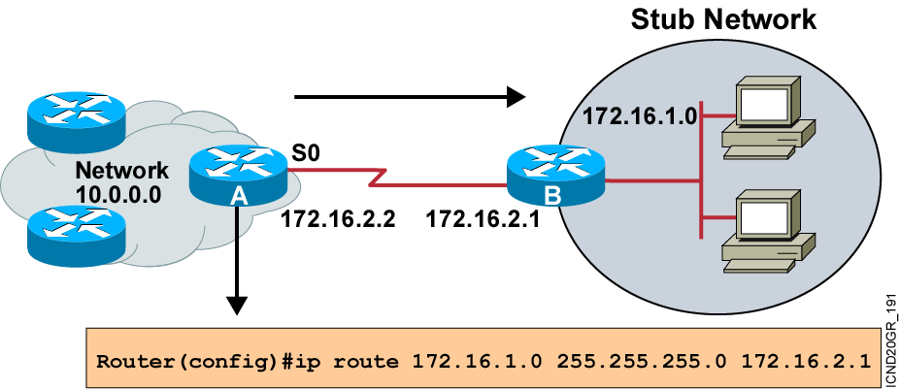
Static Route Example
  This is a unidirectional route. You must have a route configured in the opposite direction.
Notes:
Purpose: This figure gives an example of a static route configuration.

Slide 12
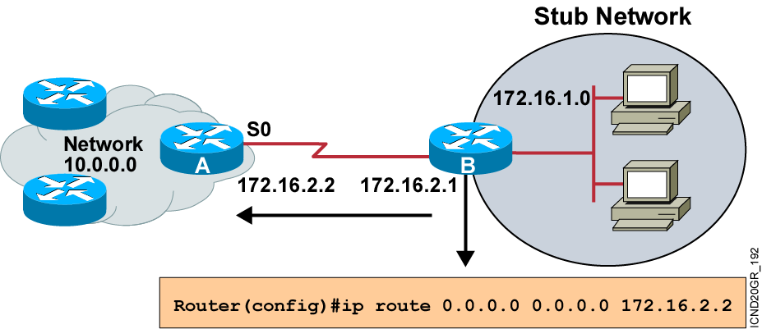
Default Routes
  This route allows the stub network to reach all known networks beyond router A.
Notes:
Purpose: This figure gives an example of a default route configuration.
Emphasize: With an address and subnet mask of 0.0.0.0 0.0.0.0 in the ip route statement, packets for any network not listed in the routing table will be sent to the next hop, 172.16.2.2.

Slide 13
Verifying the Static
Route Configuration
router#show ip route
Codes: C - connected, S - static, I - IGRP, R - RIP, M - mobile, B - BGP
D - EIGRP, EX - EIGRP external, O - OSPF, IA - OSPF inter area
E1 - OSPF external type 1, E2 - OSPF external type 2, E - EGP
i - IS-IS, L1 - IS-IS level-1, L2 - IS-IS level-2, * - candidate default
U - per-user static route
Gateway of last resort is 0.0.0.0 to network 0.0.0.0
10.0.0.0/8 is subnetted, 1 subnets
C 10.1.1.0 is directly connected, Serial0
S* 0.0.0.0/0 is directly connected, Serial0
Notes:
Slide 2 of 6
Purpose: This figure shows how the show frame-relay LMI command is used to verify the LMI type used for signaling.
Emphasize: Describe the highlighted output to the students.

Slide 14
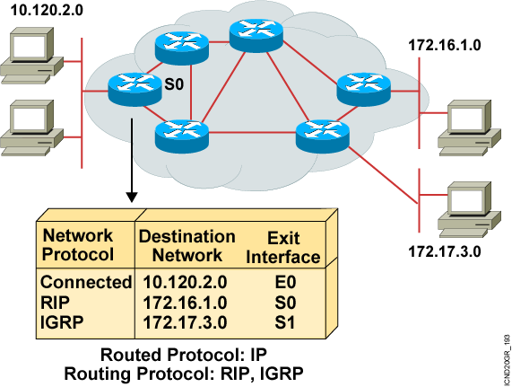
What Is a Routing Protocol?
Routing protocols are
used between
routers to determine paths and maintain
routing tables.
Once the path is determined, a router can route a routed protocol.
Notes:
Purpose: This figure introduces students to routing protocols and compares routing protocols to routed protocols.
Emphasize: If network 10.120.2.0 wants to know about network 172.16.2.0, it must learn it from its S0 (or possibly S1) interface.
Note: The two routing protocols that will be taught in this course are RIP and IGRP. They are both distance vector routing protocols.

Slide 15
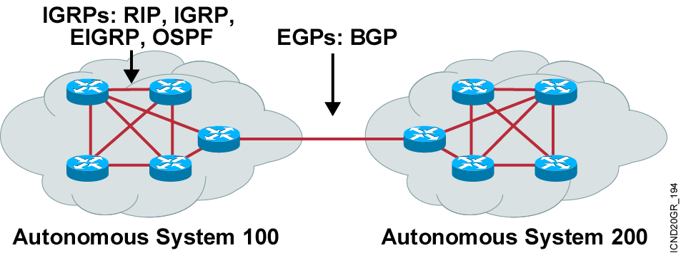
Autonomous Systems: Interior or Exterior Routing Protocols
  An autonomous system is a collection of networks under a common administrative domain.
  IGPs operate within an autonomous system.
  EGPs connect different autonomous systems.
Notes:
Purpose: This figure discusses autonomous systems, IGPs and EGPs.
Emphasize: Introduce the interior/exterior distinctions for routing protocols, as follows:
Interior routing protocols are used within a single autonomous system
Exterior routing protocols are used to communicate between autonomous systems
The design criteria for an interior routing protocol require it to find the best path through the network. In other words, the metric and how that metric is used is the most important element in an interior routing protocol.
Exterior protocols are used to exchange routing information between networks that do not share a common administration. IP exterior gateway protocols require the following three sets of information before routing can begin:
A list of neighbor (or peer) routers or access servers with which to exchange routing information
A list of networks to advertise as directly reachable
The autonomous system number of the local router

Slide 16
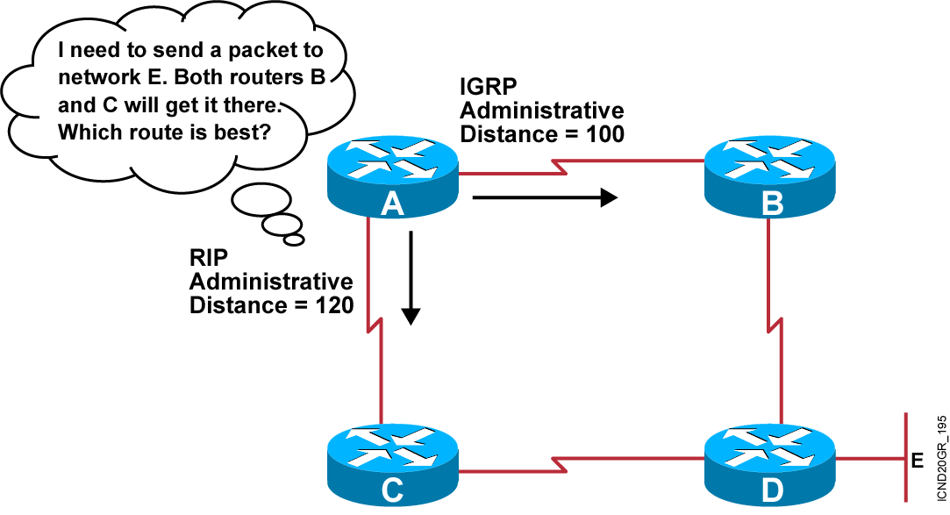
Administrative Distance:
Ranking Routes
Notes:
5
Purpose: This figure introduces administrative distance.
Emphasize: An administrative distance is a rating of the trustworthiness of a routing information source, such as an individual router or a group of routers. In a large network, some routing protocols and some routers can be more reliable than others as sources of routing information.
The default administrative distance for static routes and various routing protocols is listed in the Student Guide. The lower the distance, the more trustworthy the route is. For example, in the figure, the packet would learn the route learned via IGRP.

Slide 17
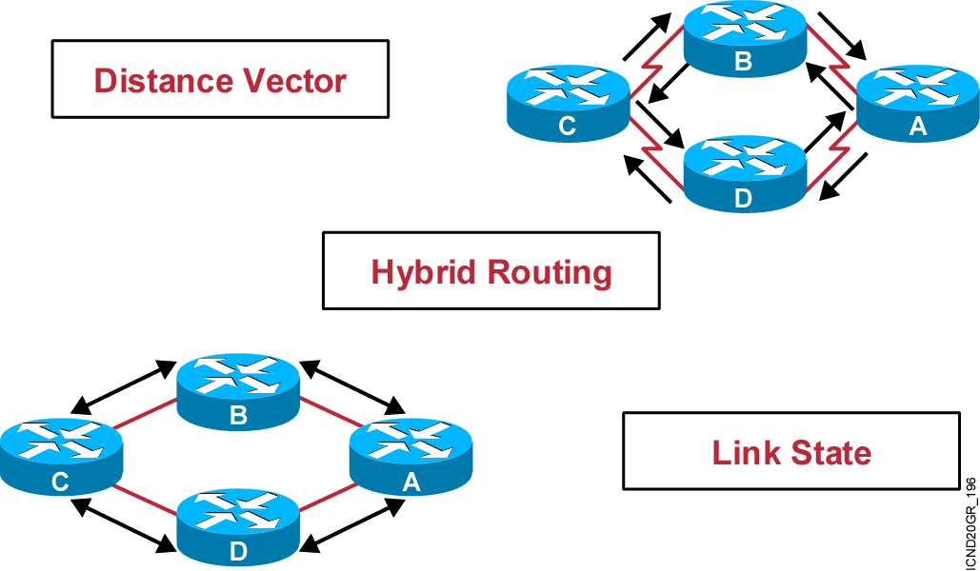
Classes of Routing Protocols
Notes:
Purpose: This figure introduces the three classes of routing protocols.
Emphasize: There is no single best routing protocol.
Note: Distance vector routing protocol operation is covered in detail later in this course. Link state and hybrid are only briefly explained after the distance vector discussion. Refer students to the ACRC to learn more about link-state and hybrid routing protocols.

Slide 18
Classful Routing Overview
  Classful routing protocols do not include the subnet mask with the route advertisement.
  Within the same network, consistency of the subnet masks is assumed.
  Summary routes are exchanged between foreign networks.
  Examples of classful routing protocols:
    RIP Version 1 (RIPv1)
    IGRP

Slide 19
Classless Routing Overview
  Classless routing protocols include the subnet mask with the route advertisement.
  Classless routing protocols support variable-length subnet masking (VLSM).
  Summary routes can be manually controlled within the network.
  Examples of classless routing protocols:
    RIP Version 2 (RIPv2)
    EIGRP
    OSPF
    IS-IS

Slide 20
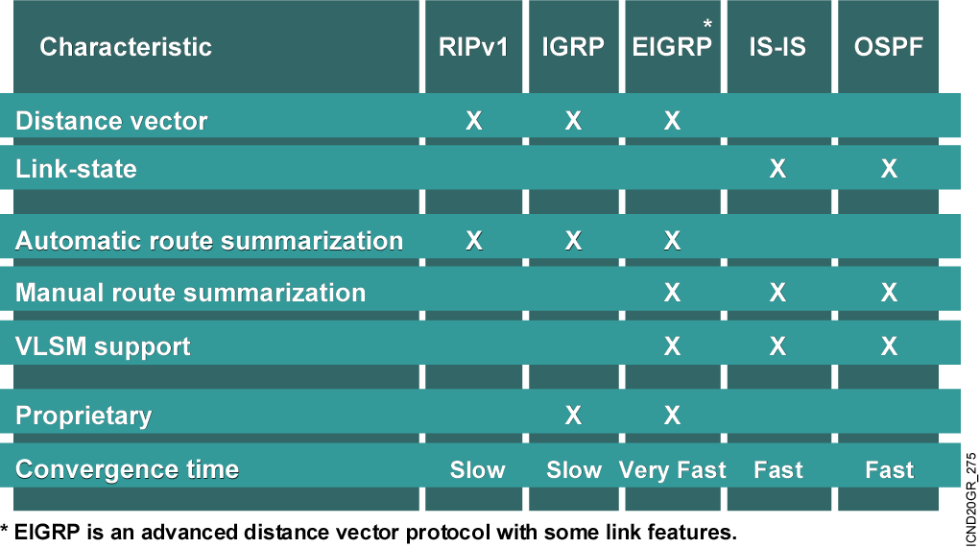
Routing Protocol
Comparison Chart

Slide 21
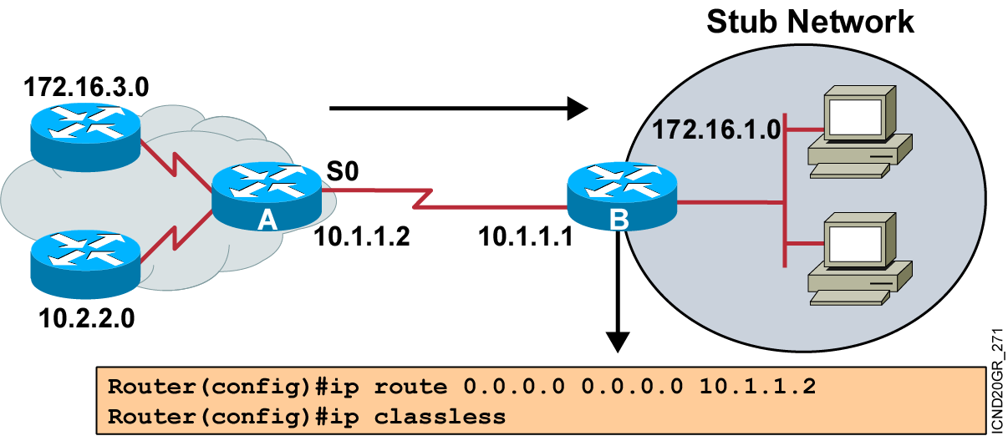
Using the ip classless Command

Slide 22
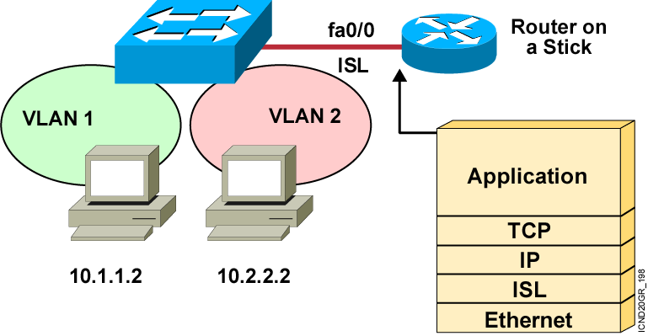
VLAN-to-VLAN Overview
Network layer devices combine multiple
broadcast domains.
Notes:
Purpose: This figure shows a router on a stick being used to interconnect VLANs.
Emphasize: The VLANs are on different networks. Without a network layer device they could not communicate.
Review the protocols operating at each of the OSI layers.

Slide 23
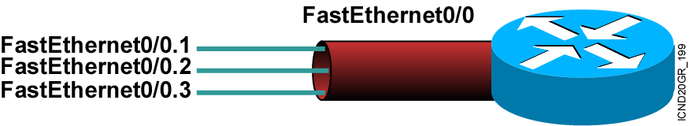
Dividing a Physical Interface into Subinterfaces
Physical interfaces can be divided into multiple subinterfaces.
Notes:
Purpose: This figure shows a subinterface example. Subinterfaces will be covered later in this course.
Emphasize: At this point, it is important for students to understand that if they want to connect multiple VLANs, they need a separate connection for each VLAN. This can be accomplished by establishing a physical connection for each VLAN that will interconnect with other VLANs, or by splitting a trunk into multiple, logical subinterfaces.

Slide 24
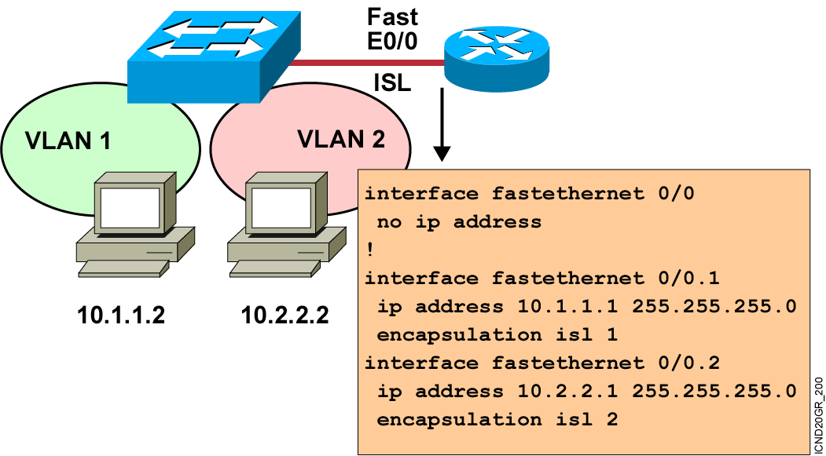
Routing Between VLANs with ISL Trunks
Notes:
Purpose: This figure shows the configuration of the router on a stick.
Emphasize: Highlight the two different interconnecting networks, 10.1.1.0 and 10.2.2.0.

Slide 25
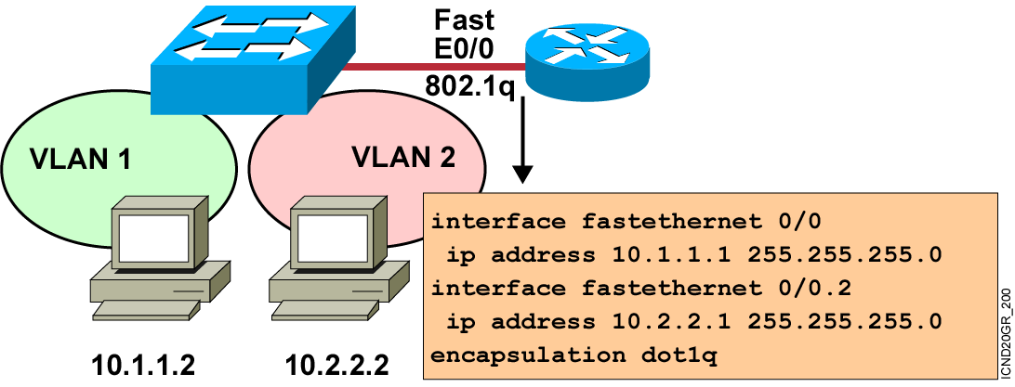
Routing Between VLANs with 802.1Q Trunks
Notes:
Purpose: This figure shows the configuration of the router on a stick.
Emphasize: Highlight the two different interconnecting networks, 10.1.1.0 and 10.2.2.0.

Slide 26
Summary
  Routing is the process by which an item gets from one location to another. In networking, a router is the device used to route traffic.
  Routers can forward packets over static routes or dynamic routes, based on the router configuration.
  Static routes can be important if the Cisco IOS software cannot build a route to a particular destination. Static routes are also useful for specifying a “gateway of last resort” to which all unroutable packets will be sent.
  A default route is a special type of static route used for situations when the route from a source to a destination is not known or when it is unfeasible for the routing table to store sufficient information about the route.
Notes:
Purpose: This slide discuss the initial configurations on the routers and switches.
Note: There is no setup mode on the Catalyst 1900 switch.

Slide 27
Summary (Cont.)
  When the static routing configuration is complete, use the show ip route command to verify the configuration.
  Dynamic routing relies on a routing protocol to disseminate knowledge. A routing protocol defines the set of rules used by a router when it communicates with neighboring routers.
  The ip classless command prevents a router from dropping a packet destined for an unknown subnet.
  In a VLAN environment, frames are only switched between ports within the same broadcast domain so a Layer 3 device is required to enable inter-VLAN communication. Use ISL or 802.1q to enable trunking on a router’s subinterface.

Slide 28


